Slide 1
POISSON REGRESION
Modeling count data

Slide 2
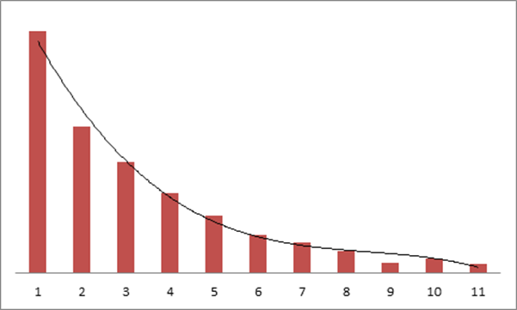
Poisson regression is appropriate when the dependent variable is count data
Count of units, transactions, responses, visits, purchases, etc.
OLS is inappropriate because the distribution is Poisson, not normal
CRITICAL ASSUMPTION : mean = variance

Slide 3
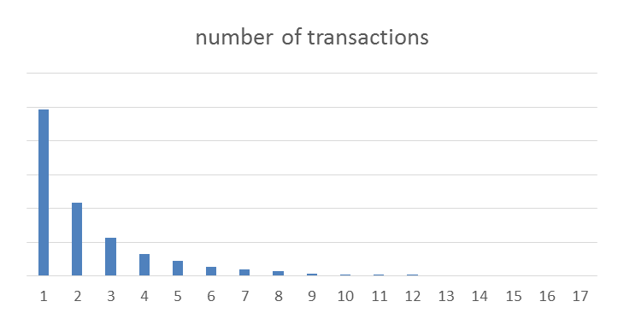
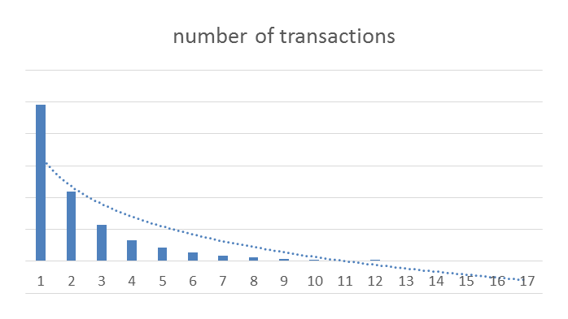
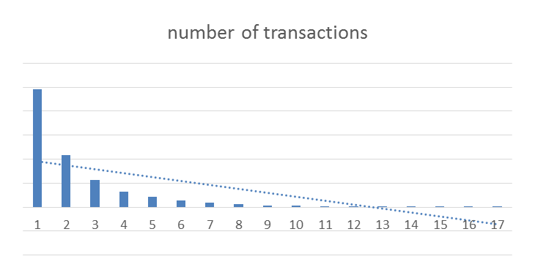
POISSON REGRESSION
POISSON regression is about modeling count data
Usually in such marketing data, there are a large number of 0s or 1s and then the distribution quickly decreases
KEY ASSUMPTION: the MEAN = VARIANCE
Applying OLS is a typical choice but look where the regression line is
The mean is 2.35
mean

Slide 4
Comparing ols to poisson regression
proc reg data = merge;
model total_txns = hhage hhkids cmpns tenure;
output out = regress p = predicted;
run;
proc countreg data=merge;
model total_txns = hhage hhkids cmpns tenure / dist=poisson ;
output out = poisson pred = predicted;
run;
proc corr data = regress;
var total_txns predicted; run;
proc corr data = poisson;
var total_txns predicted; run;
Two other ‘flavors’ of poison regression:
ZERO INFLATED
If too many zeros
NEGATIVE BINOMIAL
If over dispersed (variance is larger than means

